Slide 1
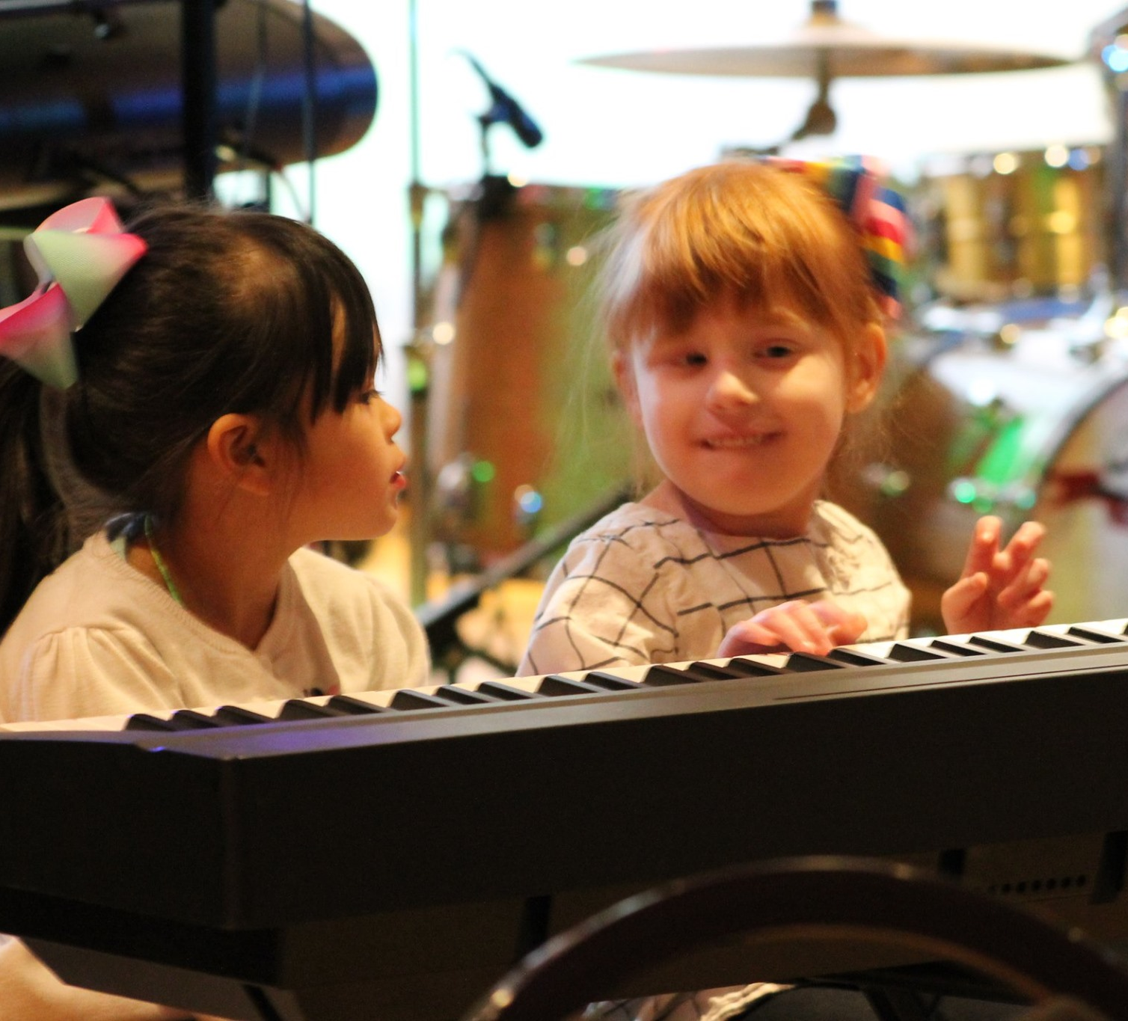
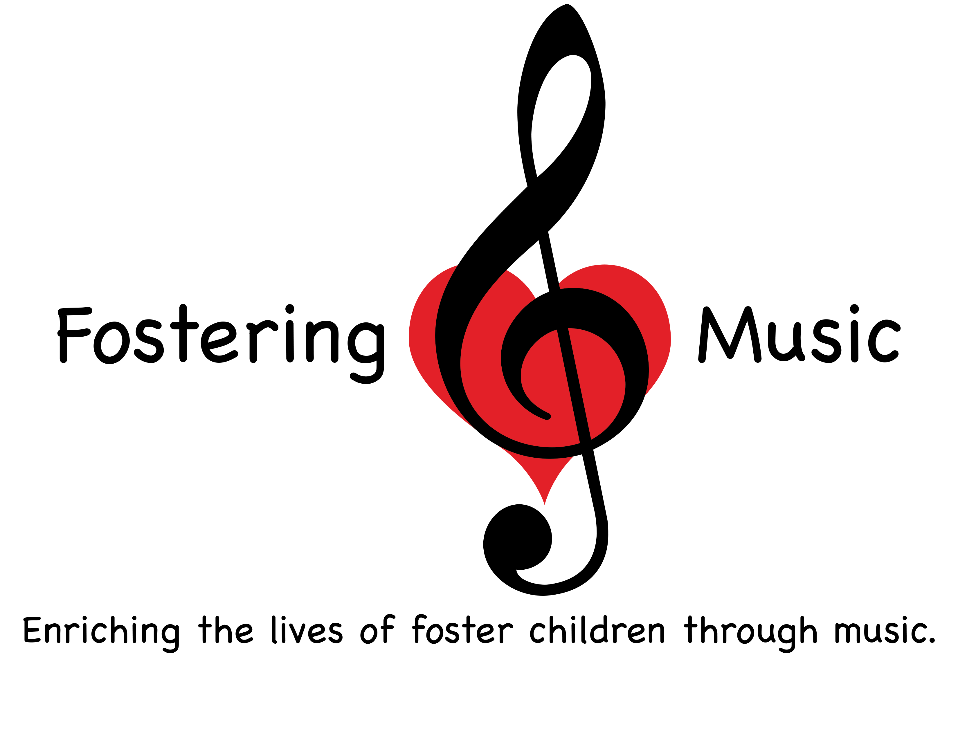

Slide 2
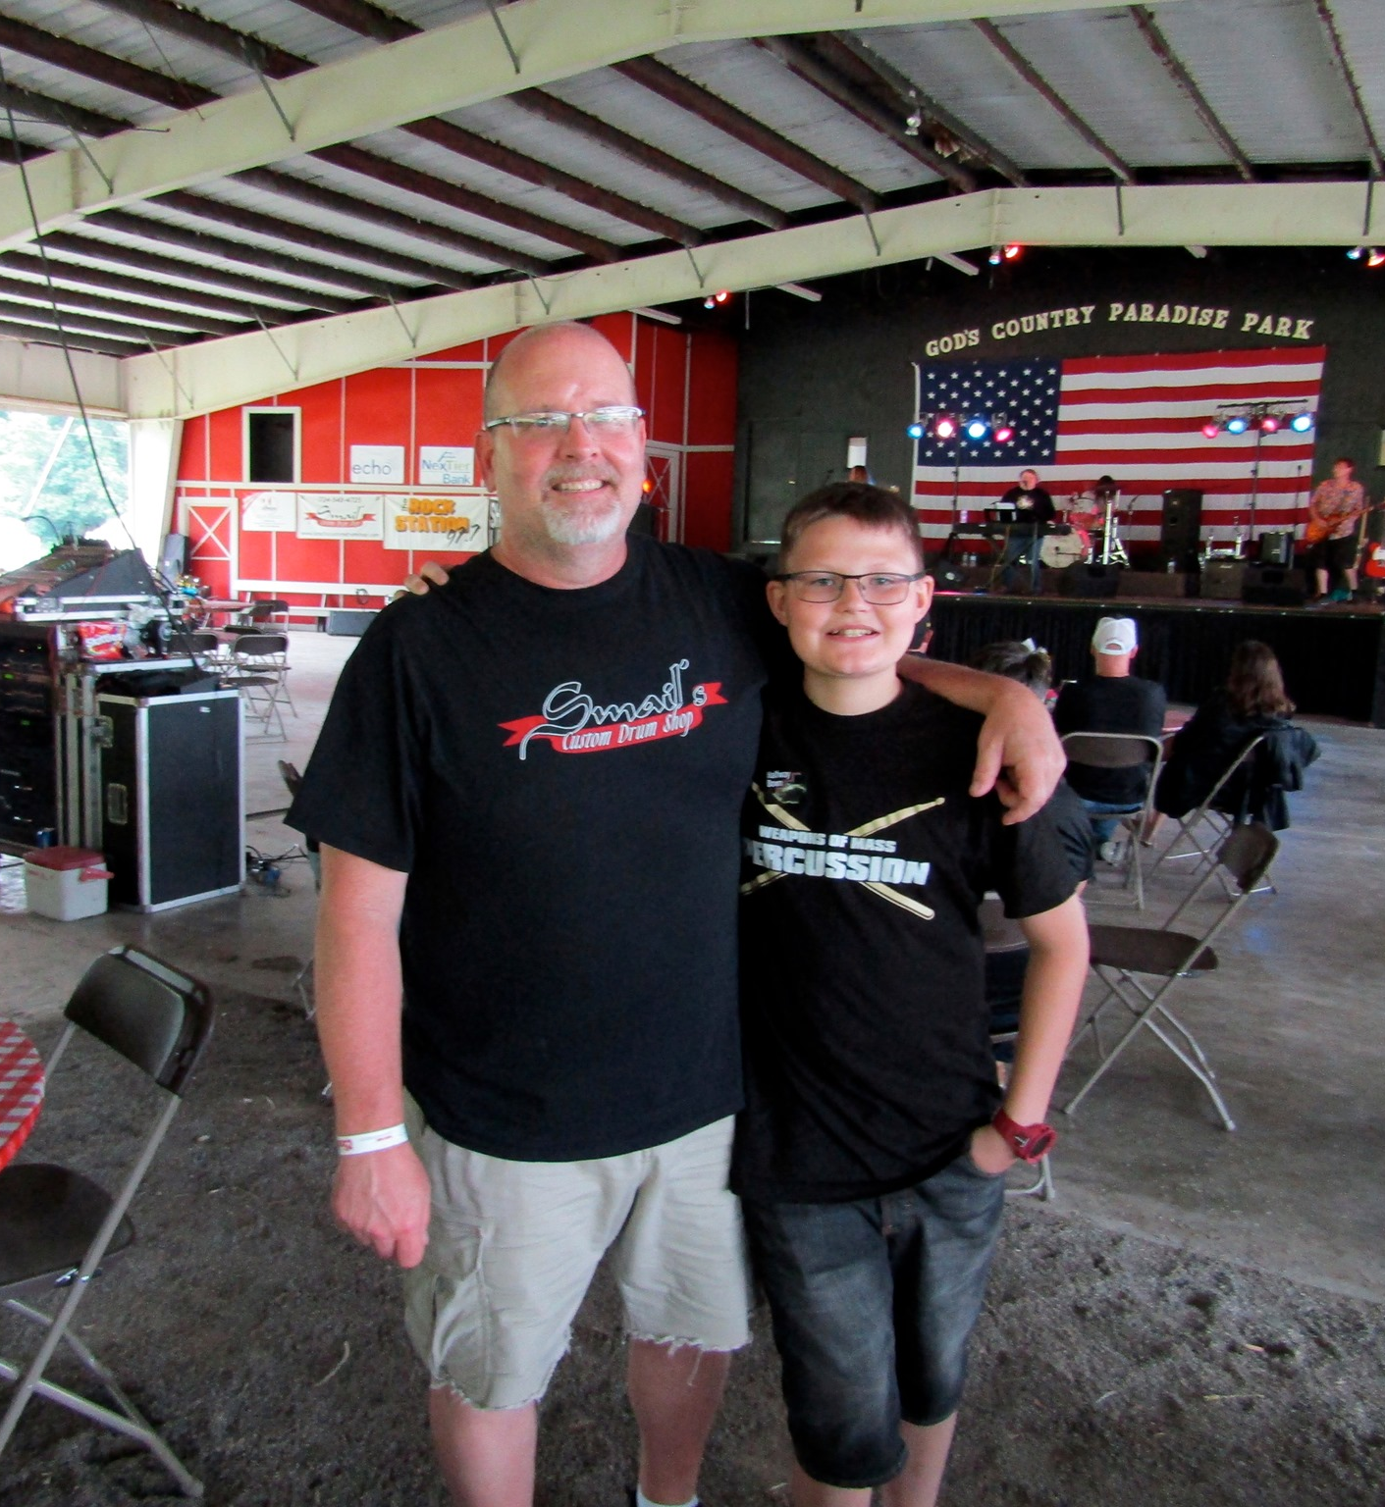
Our Mission
Fostering Music is a charitable organization dedicated to enriching the lives of children currently in, or adopted out of, the foster care system by providing musical instruments and quality music instruction in conjunction with local music stores. By partnering with local foster care agencies, we are able to identify the children in Western Pennsylvania with the greatest need.

Slide 3
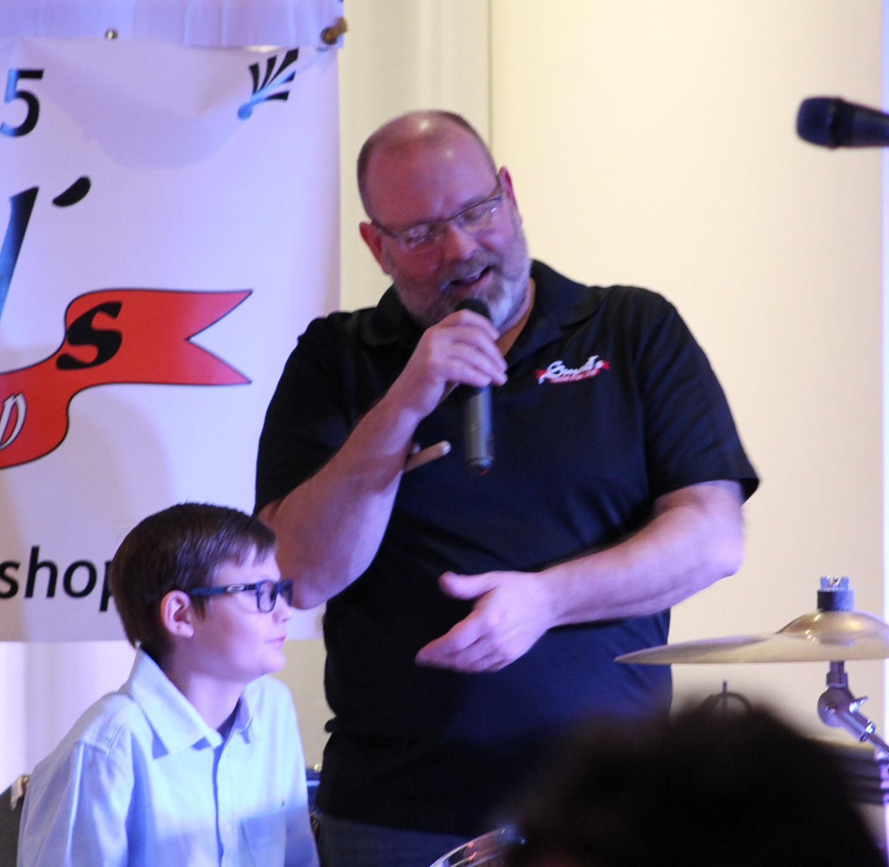
Our Growth
Since we started our mission in the Fall of 2018:
We’ve provided more than 40 kids with lessons and instruments.
We have 11 kids currently participating in weekly lessons through our program.
We’ve grown our social media presence to more than 1,000 Facebook followers.
We’ve expanded into six Western PA counties: Allegheny, Armstrong, Butler, Mercer, Washington, and Westmoreland.

Slide 4
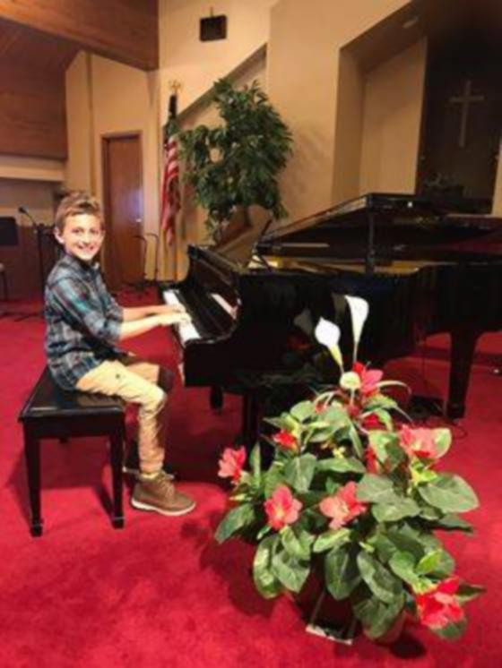
Feedback From the Children In Our Program
“Being able to continue piano lessons has meant a lot. It makes me feel good because I can express myself. I love to listen to songs and then try to play them. I also love learning how to read music — it builds my confidence.” - V. age 10, Piano
“Getting a saxophone allowed me to practice something I love and am passionate about once again. The instrument gave me a chance to be myself and play.” - D. age 15, Saxophone

Slide 5
Feedback From the Families In Our Program
“Our 17-year-old granddaughter came to live with us recently during a very difficult time in her life. You providing this trumpet was a God-send, as we didn’t have the money to buy her one. Thank you for providing this important gift of music to a young girl who is encouraged and surprised that complete strangers would do this for her. You are a blessing!” - Grandfather of a 17-year-old who received a trumpet
“Our son that we just adopted through the foster care system has a lot of anxiety. We … had no luck finding anything that he was willing to do that required leaving the house. At school … he discovered the electric piano and was instantly mesmerized by it. He loved that he can make his own music and wanted to have lessons to learn how … [O]ur son has opened up and blossomed and shown so much growth. With music … he is learning new ways to work through his anxiety. It is truly amazing to see how music can touch a child’s heart! We are forever grateful that such an amazing organization exists and can provide these services for foster/adoptive children!” - Family of a 10-year-old pianist

Slide 6
Our Current Needs
Immediate Financial Needs We currently support $1,105.00 worth of music lessons per month, for children in our program. Only $330.00 per month is covered by a monthly donor, which leaves us to generate an additional $775 each month.
Additional Needs Some of the children coming into our program not only need to be provided with lessons, but they also need instruments and music stands as well. We can source new instruments through financial donations, but we also accept instrument/equipment donations.

Slide 7
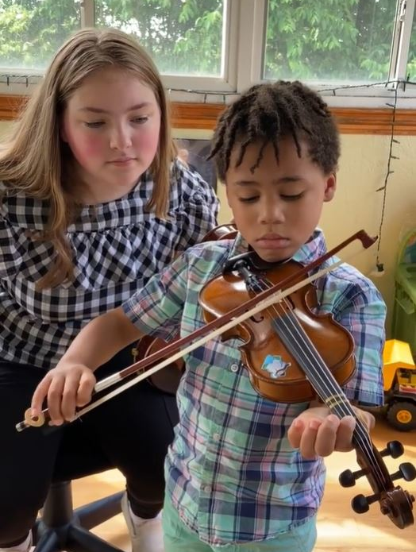
Ways You Can Help
Like our Facebook page and Instagram account to keep up with current needs and accomplishments.
Donate through our DonorBox link on our website and Facebook page or through the direct link: donorbox.org/sponsorship-donations-1.
Donate used instruments to help lower the costs of getting children started in our program.
Sponsor our annual Summer Shindig.

Slide 8
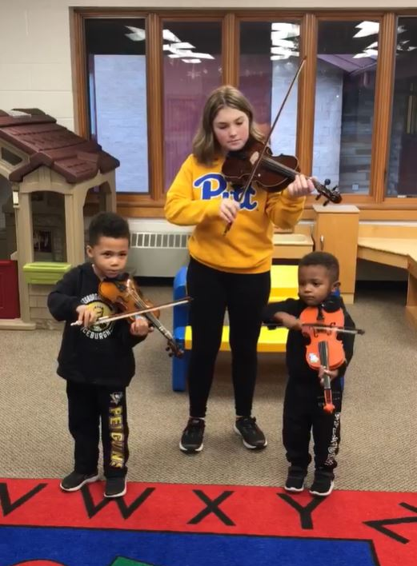
Connect With Us!
@FosteringMusic
@Fostering.Music
www.fosteringmusic.com
cjstitt@fosteringmusic.com

Slide 9
Questions?

